Slide 1

Data Analyst Capstone Project Report
Julio Cesar Zamora Ramirez
5/25/2026

Slide 2



OUTLINE
Executive Summary
Introduction
Methodology
Results
Visualization – Charts
Dashboard
Discussion
Findings & Implications
Conclusion
Appendix

Slide 3

EXECUTIVE SUMMARY
Python is the future JavaScript leads today, but Python ranks #1 in what developers want to learn next — driven by AI and data science.
AI is already mainstream 57% of developers use AI tools daily. Not a future trend — the present reality.
Remote work is permanent 76% work remotely or hybrid. Cloud-native infrastructure is now the baseline.
PostgreSQL overtook MySQL Open-source, enterprise-grade databases are winning. Cloud databases like BigQuery are rising fast.
Developers are pivoting to data Frontend is declining. Python, Rust, SQL, and cloud are rising — the industry is shifting toward data engineering and AI.

Slide 4

INTRODUCTION
Where developers are today? Current technology landscape — languages, databases, platforms, and frameworks powering the industry in 2024.
Where developers are heading? Future trends — what the global developer community wants to learn next and why it matters.
Who the developers are? Demographics — age, education, employment, and work arrangements of 18,845 survey respondents worldwide.
What it means for your organization? Strategic recommendations — actionable insights to align your talent and technology strategy with where the industry is going.

Slide 5

METHODOLOGY
Data Source Stack Overflow Developer Survey 2024 — 18,845 respondents globally across 180+ countries.
Data Collection Raw dataset extracted via API call using Python requests library from IBM's cloud storage endpoint.
Data Wrangling Cleaned with Python and pandas — removed duplicates, handled missing values, narrowed 114 columns to 13 relevant variables, split multi-value fields using explode().
Transformation & Visualization Data transformed using dbt models in PostgreSQL, visualized in Google Looker Studio across 3 interactive dashboards.

Slide 6
Results
Our results have been …..

Slide 7
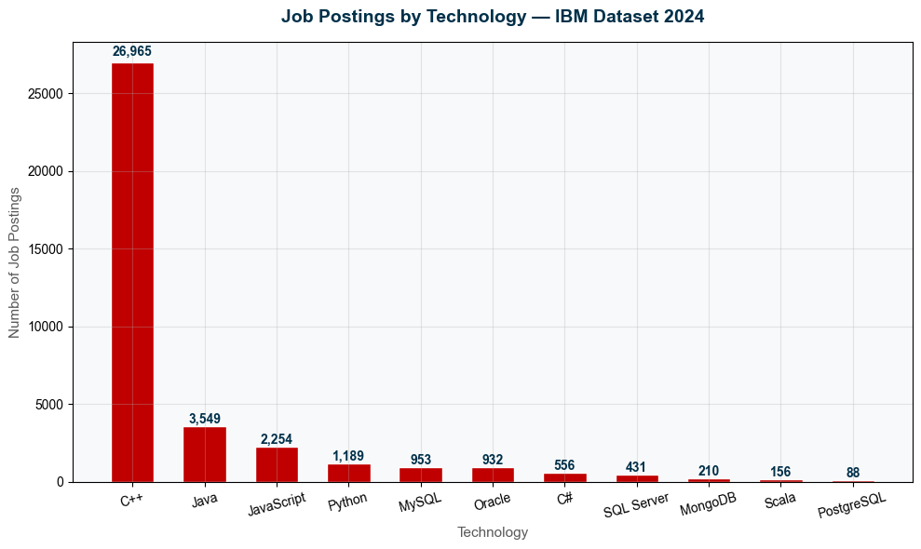
JOB POSTINGS
While Python leads in developer learning interest, C++ and Java still dominate actual job market demand — highlighting a gap between what developers want to learn and what employers need.

Slide 8
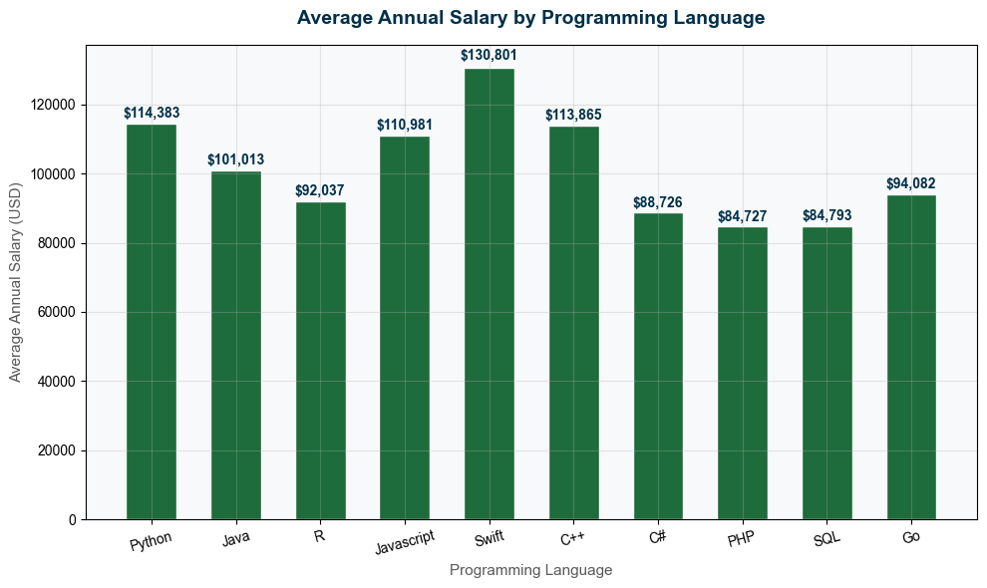
POPULAR LANGUAGES
Python and C++ are great salaries, but Swift is above and beyond every other language with an average salary of $130,801.00.

Slide 9
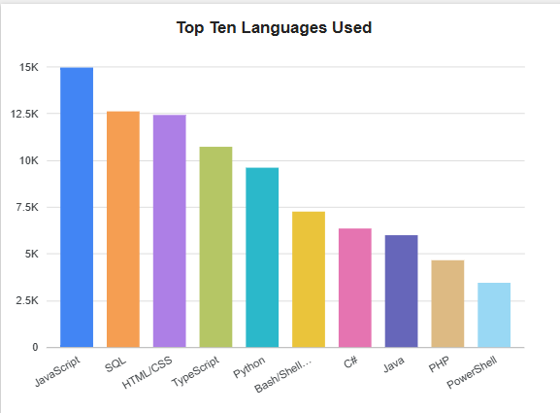
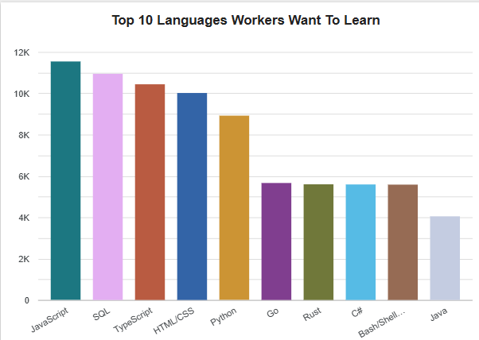
PROGRAMMING LANGUAGE TRENDS
JavaScript and SQL are the top languages that people are interested and want to learn.
Current Year
Next Year

Slide 10
PROGRAMMING LANGUAGE TRENDS - FINDINGS & IMPLICATIONS
Findings
JavaScript and SQL dominate
HTML/CSS are still very popular
Data languages are on the rise
Implications
JavaScript and SQL aren’t going anywhere
People are still very much interested in Web Design
The job market speaks for itself, big data is the future

Slide 11
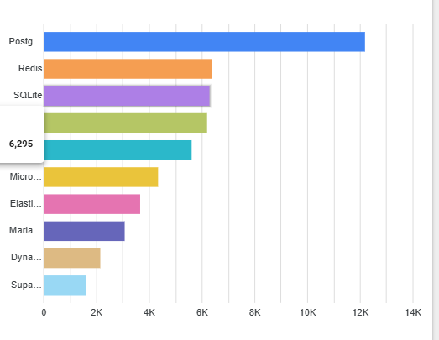
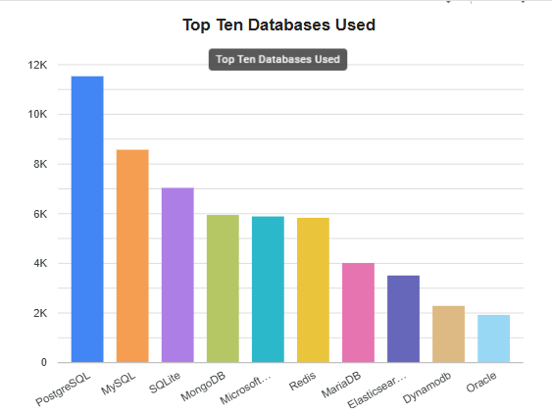
DATABASE TRENDS
PostgreSQL is reigns supreme; people know it and want to learn it.
Current Year
Next Year

Slide 12
DATABASE TRENDS - FINDINGS & IMPLICATIONS
Findings
PostgreSQL is King
Any variant of SQL is popular
Oracle is surprisingly low for such a popular database
Implications
PostgreSQL is highly in demand
The future and present is SQL
Oracle seems like its falling behind

Slide 13

DASHBOARD
My Dashboards….

Slide 14
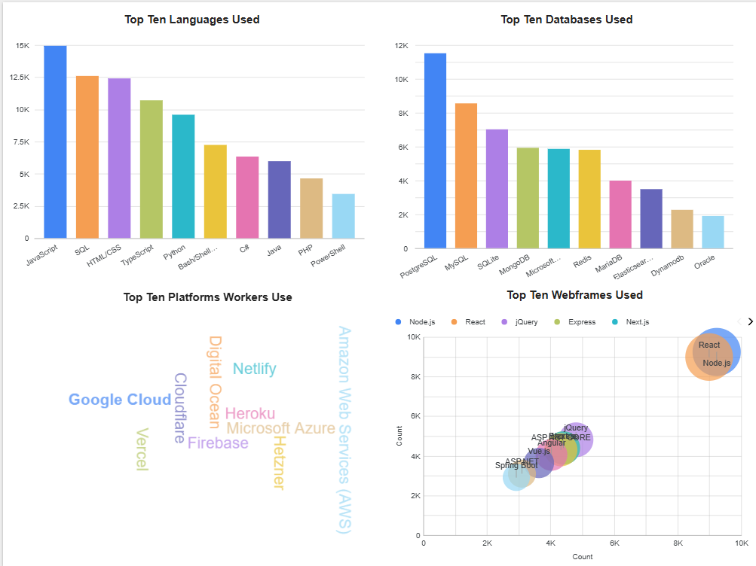
DASHBOARD TAB 1: Current Technology Usage
JavaScript and SQL dominate the languages that people currently know, as for Databases PostgreSQL and MySQL are most popular.
For the top performing platform that workers use Amazons AWS is most wanted, followed by Google Cloud. As for web frames React and Node JS are above and beyond everything else.

Slide 15
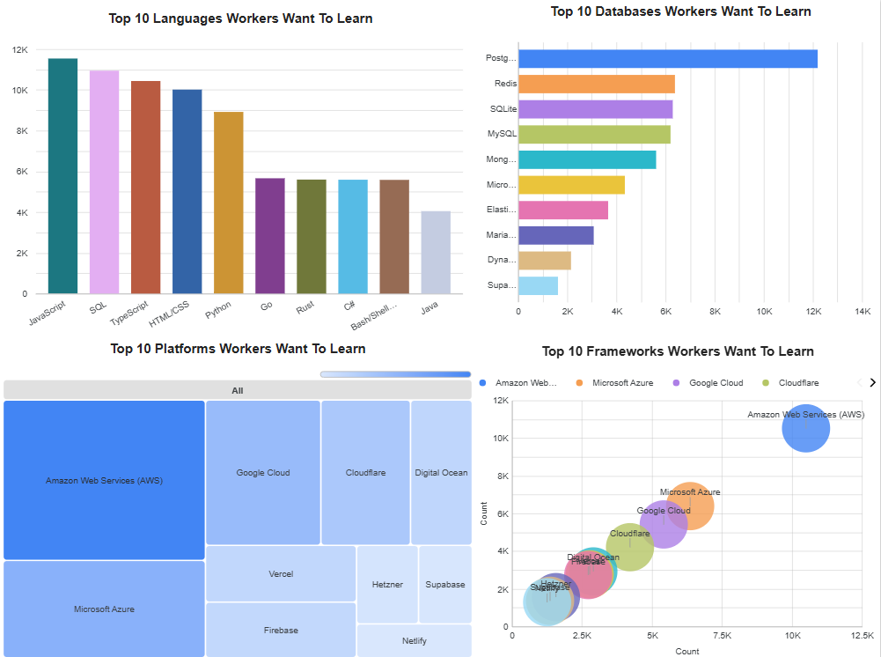
DASHBOARD TAB 2: Future Technology Trends
For the future JavaScript and SQL are the most sought after languages people want to learn. For Databases PostgreSQL is the number one by a great margin.
For in demand platforms Amazons AWS is the gold standard for what companies use and what they seek.

Slide 16
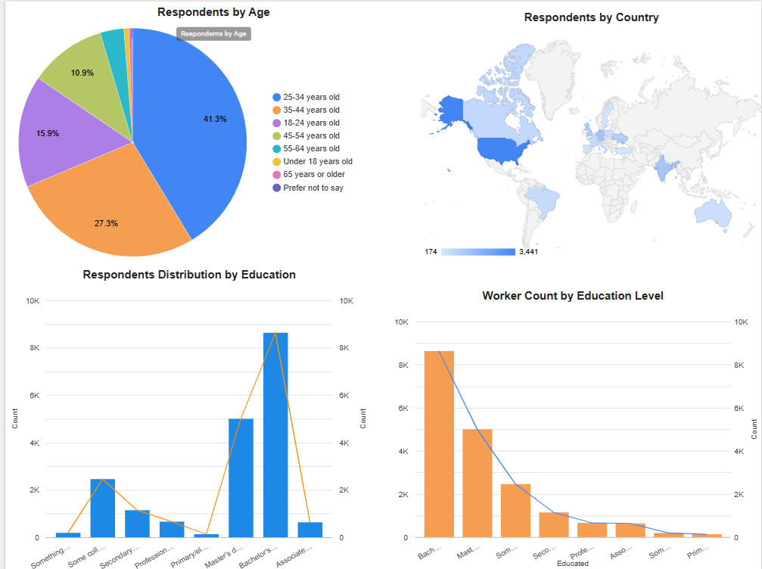
DASHBOARD TAB 3: Demographics
Respondents by age are a majority in the 25- 44 age range.
A large chunk of our respondents are from the USA and Europe , a long with a few in Asia, Oceana, and South America.
For Education Level peoples with a Bachelorettes degree are the majority in this field.

Slide 17
DISCUSSION
The data tells a clear story — Python is the single best technology investment for both developers and organizations. It ranks #1 in desired learning, commands a $114K average salary, and aligns directly with AI and data engineering — the fastest growing sector in tech.

Slide 18
OVERALL FINDINGS & IMPLICATIONS
Findings
Swift pays a lot
Python is a safe investment
C++ is not going anywhere
Implications
Swift pays well, but deman is low
Master Python and you will always have a job
C++ is still used for engineering roles

Slide 19

CONCLUSION
Swift pays the most but has low job demand At $130,801 Swift leads in salary but barely appeared in job postings. High pay, niche market — mostly Apple/iOS development.
Python is the best overall investment $114,383 salary, #1 in developer learning interest, and strong job market demand. Best combination of pay, demand, and future growth.
C++ has the most job postings but mid-range salary 26,000+ job postings but $113,865 salary. High demand in systems engineering, gaming, and embedded systems — but not the highest paying.
PHP and SQL are the lowest paying At $84,727 and $84,793 respectively — both are mature technologies with declining appeal. Developers are actively moving away from PHP toward Python and JavaScript based on the survey data.

Slide 20

APPENDIX
The Road Ahead: AI & Big Data Will Define the Decade
The trajectory is unambiguous. AI and big data are not adjacent to the software industry — they are becoming its foundation. Organizations that treat AI adoption as a long-term project risk falling behind competitors who are embedding it into operations today.

